Slide 1
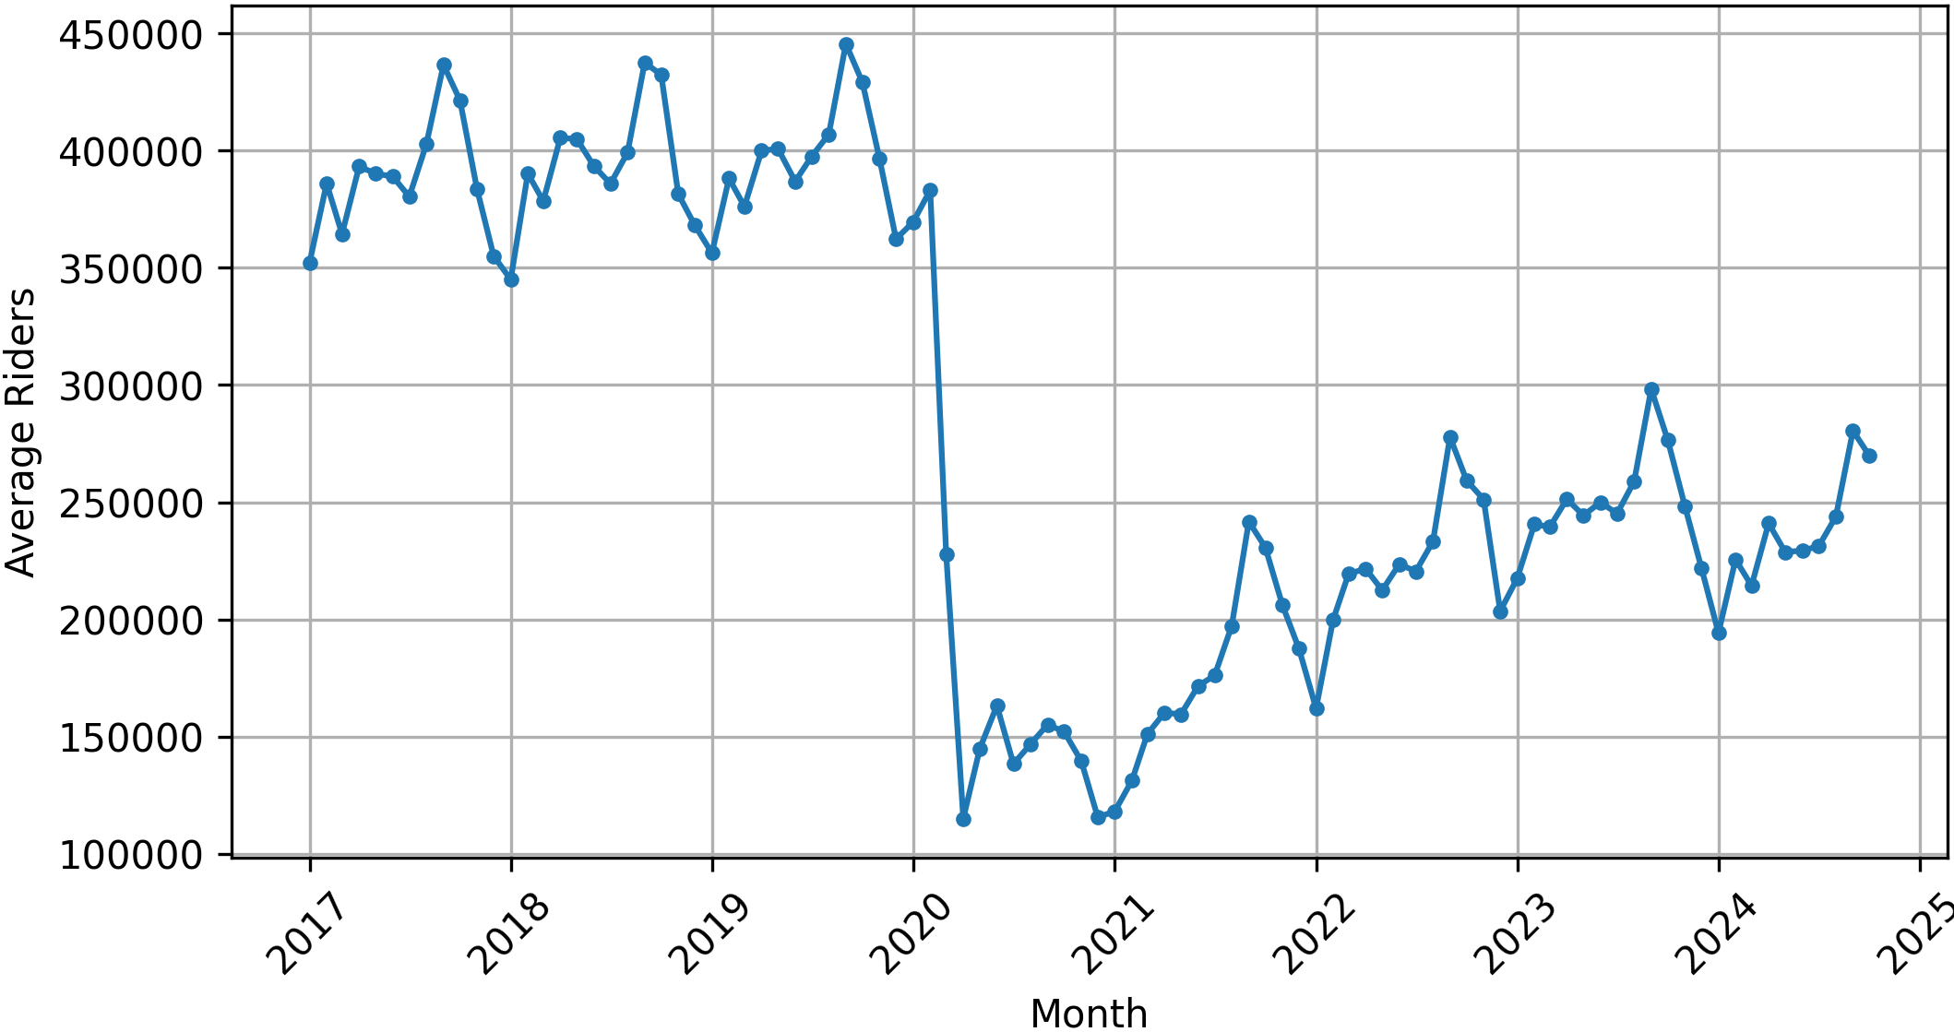
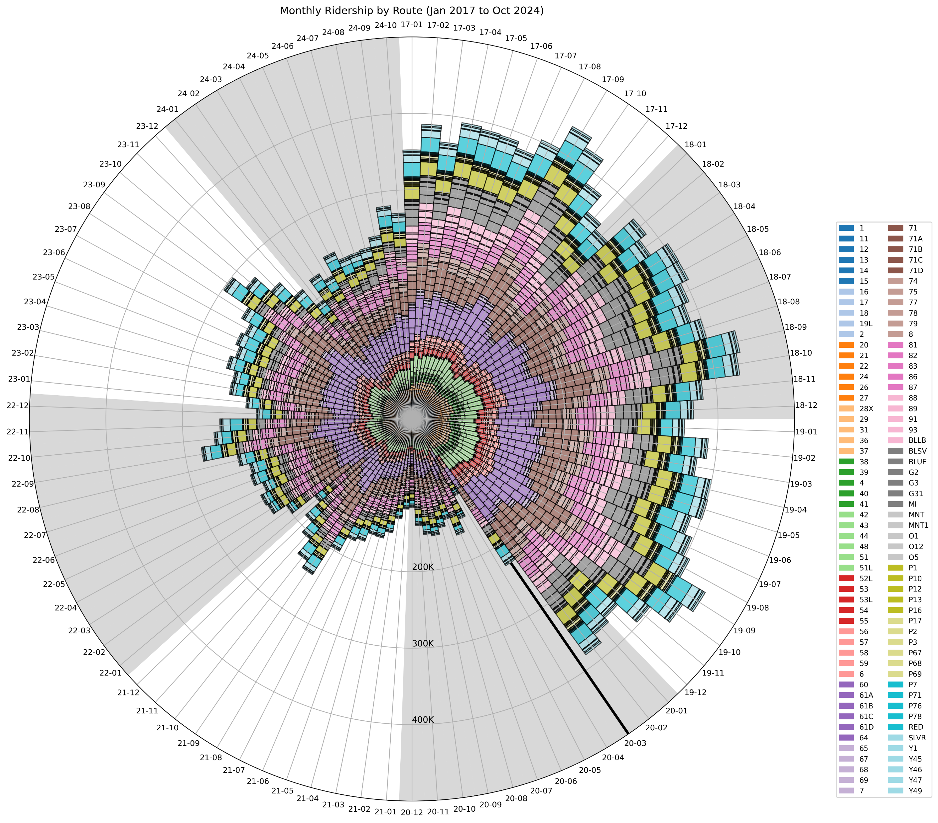
Pittsburgh Regional Transit Utilization Eric Laslo ERL67@pitt.edu

Slide 2
Legend
The outer circle denotes the month, going clockwise from Jan 2017 to Oct 2024
Each large pie slice (alternating gray and white) represents the entire year
The small radial lines represent a month
The length of the bar is the total monthly ridership
Each bar is divided into the individual routes by color
The segment size of each bar is the total ridership on that route for that month
The bar color groupings generally align with the various routes and make it easier to see
The radius of the circle denotes the total ridership in intervals of 100,000, going to a maximum of 500,000
The thick black line on the 20-03 radii indicates the start of the Covid-19 pandemic
Findings
The graph shows how much the ridership dropped during the pandemic, starting March 2020.
The graph also shows how the ridership has only recovered to approximately 65% of pre-pandemic levels.
Also of note is that ridership peaks each year around August and September, which correlates with the start of the school year.
Could be useful when analyzing bus route realignment and prioritizing certain routes.
Data Source
https://data.wprdc.org/dataset/prt-monthly-average-ridership-by-route
Github
https://github.com/erl67/prt-utilization

